Slide 1
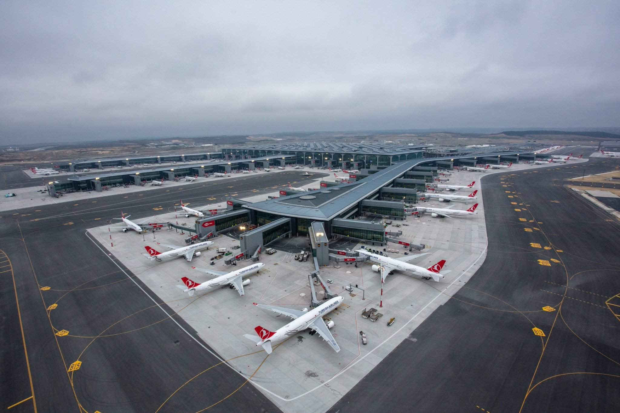
SkyLink: A Comprehensive Airline Operations and Management Solution
BY :-
Lalith Krishna :- RA2211056010095
Manas Sharma :- RA2211056010132
Heer Mehta :- RA2211056010122

Slide 2
Description
Database management system helps making data more efficient and effective. This system stores, organises and manages a large amount of information within a single software application.
Our Project on airline database system holds flight details, flight schedule, passenger details, ticket records, etc.
We have used SQL as an language for applying queries. (Queries for insertion, deletion, updating, etc.)
Benefits –
Control redundancy in data storage and in development of effort.
It Provides a structured approach to managing risks.
It Reduces risk by streamlining continuous improvement to operations.
Improve maintenance through data independence also backup and recovery services.

Slide 3
Entity Sets & Attributes
Airplane_type( A_ID, Capacity, A_weight, Company ,Flight_ID*)
Route ( Route_ID, Destination,Take_Off_point,R_type )
Flight ( Flight_ID, Departure, Arrival, Flight_date, A_ID*)
AirFare ( Fare_ID, Charge_Amount, Description )
Passengers ( Ps_ID, Name, Address, Age, Sex, Contacts, Flight_ID* )
Employees ( Emp_ID, Name, Address ,Age, Email_ID, Contacts, Air_code* )
Travel_On(Route_ID*, Flight_ID*)
Transactions( TS_ID, Booking_Date, Departure_Date,Type,Emp_ID*,Ps_ID*, Flight_ID*, Charge_Amount* )
Countries( Country_code, Country_Name )
Airport( Air_Code, Air_Name, City, State, Country_code* )
Can_Land(Air_Code*, Flight_ID*)

Slide 4
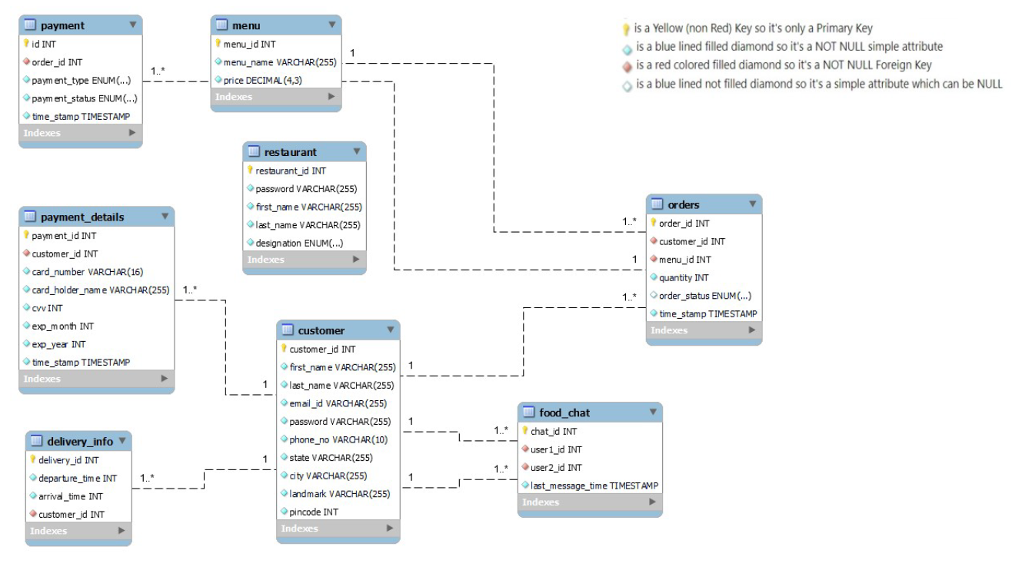
Relational Schema

Slide 5
RELATIONSHIPS, CARDINALITY AND PARTICIPATION
Type : ( 1:M ) Airplane_type with Flight ,
Both total
Payment : ( 1:M ) Passengers with Transactions,
Both total
Can land : ( M:N ) Flight with Airport,
Both total
Travels on : ( M:N ) Flight with Route
Flight: total Route: partial

Slide 6
RELATIONSHIPS, CARDINALITY AND PARTICIPATION
Assigned : ( N:1 ) Air-Fare with Flight,
Both Total
Part of : ( N:1) Airport with Countries,
Both Total
Works_for : ( N:1 ) Employee with Airport,
Both Total
belongs_to : ( N:1 ) Passenger with Flight,
Both Total

Slide 7
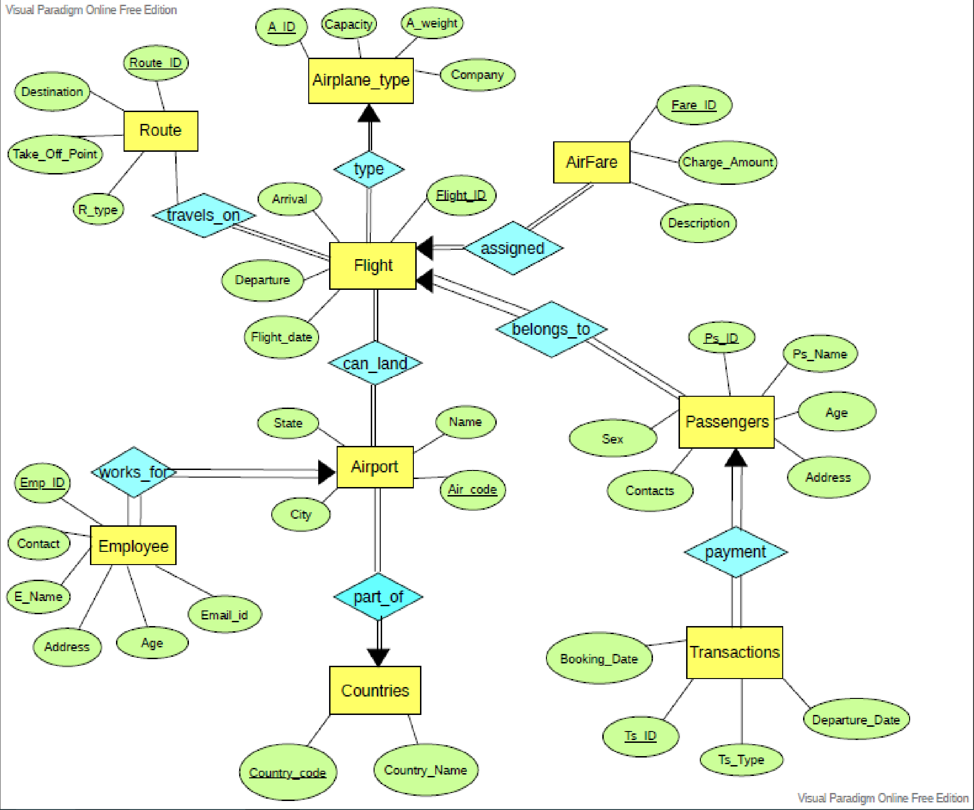
ENTITY RELATIONSHIP DIAGRAM

Slide 8
RELATIONAL MODEL
Airplane_type ( A_ID, Capacity, A_weight, Company )
Route ( Route_ID, Destination,Take_Off_point,R_type )
Flight ( Flight_ID, Departure, Arrival, Flight_date, A_ID* )
AirFare ( Fare_ID, Charge_Amount, Description, Flight_ID* )
Passengers ( Ps_ID, Name, Address, Age, Sex, Contacts, Flight_ID* )

Slide 9
RELATIONAL MODEL
Employees ( Emp_ID, Name, Address ,Age, Email_ID, Contacts, Air_Code* )
Transactions ( TS_ID, Booking_Date, Departure_Date, Type, Emp_ID*, Ps_ID*, Flight_ID*, Charge_Amount*)
Countries ( Country_code, Country_Name )
Airport ( Air_Code, Air_Name, City, State, Country_code* )
Can_Land ( Air_Code*, Flight_ID* )
Travels_on ( Route_ID*, Flight_ID* )

Slide 10
Table Create
CREATE TABLE Airplane_type(
A_ID INT,
Capacity INT,
A_weight INT,
Company VARCHAR(15),
PRIMARY KEY(A_ID)
);
CREATE TABLE Route(
Route_ID INT,
Take_Off_point VARCHAR(15),
Destination VARCHAR(15),
R_type VARCHAR(15),
PRIMARY KEY(Route_ID)
);
CREATE TABLE Flight(
Flight_ID VARCHAR(15),
Departure VARCHAR(30),
Arrival VARCHAR(30),
Flight_date DATE,
A_ID INT,
PRIMARY KEY(Flight_ID),
FOREIGN KEY (A_ID) REFERENCES Airplane_type(A_ID)
);

Slide 11
CREATE TABLE AirFare(
Fare_ID INT,
Charge_Amount INT,
Description VARCHAR(25),
Flight_ID VARCHAR(15),
PRIMARY KEY(Fare_ID),
FOREIGN KEY (Flight_ID) REFERENCES Flight(Flight_ID)
);
CREATE TABLE Passengers(
Ps_ID INT,
Ps_Name VARCHAR(20),
Address VARCHAR(50),
Age INT,
Sex VARCHAR(1),
Contacts VARCHAR(10),
Flight_ID VARCHAR(15),
PRIMARY KEY(Ps_ID),
FOREIGN KEY (Flight_ID) REFERENCES Flight(Flight_ID)
);
CREATE TABLE Countries(
Country_code INT,
Country_Name VARCHAR(20),
PRIMARY KEY(Country_code)
);

Slide 12
CREATE TABLE Airport(
Air_code VARCHAR(10),
Air_Name VARCHAR(50),
City VARCHAR(20),
State VARCHAR(20),
Country_code INT,
PRIMARY KEY(Air_code),
FOREIGN KEY (Country_code) REFERENCES Countries(Country_code)
);
CREATE TABLE Employees(
Emp_ID INT,
E_Name VARCHAR(20),
Address VARCHAR(50),
Age INT,
Email_ID VARCHAR(20),
Contact VARCHAR(20),
Air_code VARCHAR(10),
PRIMARY KEY(Emp_ID),
FOREIGN KEY (Air_code) REFERENCES Airport(Air_code) );
CREATE TABLE Can_Land(
Air_code VARCHAR(10),
Flight_ID VARCHAR(15),
PRIMARY KEY(Air_code,Flight_ID),
FOREIGN KEY(Air_code) REFERENCES Airport(Air_code),
FOREIGN KEY(Flight_ID) REFERENCES Flight(Flight_ID)
);

Slide 13
CREATE TABLE Transactions(
TS_ID INT,
Booking_Date DATE,
Departure_Date DATE,
TS_Type VARCHAR(20),
Emp_ID INT,
Ps_ID INT,
Flight_ID VARCHAR(15),
Charge_Amount INT,
PRIMARY KEY(TS_ID),
FOREIGN KEY (Emp_ID) REFERENCES Employees(Emp_ID) ,
FOREIGN KEY (Ps_ID) REFERENCES Passengers(Ps_ID),
FOREIGN KEY (Flight_ID) REFERENCES Flight(Flight_ID),
FOREIGN KEY (Charge_Amount) REFERENCES AirFare(Fare_ID) );
CREATE TABLE Travels_on(
Route_ID INT,
Flight_ID VARCHAR(15),
PRIMARY KEY(Route_ID,Flight_ID),
FOREIGN KEY(Route_ID) REFERENCES Route(Route_ID),
FOREIGN KEY(Flight_ID) REFERENCES Flight(Flight_ID) );

Slide 14
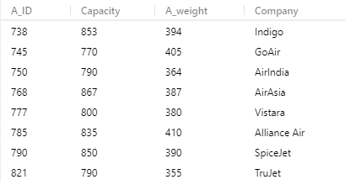
Insert Data
INSERT INTO Airplane_type VALUES (738,853,394,'Indigo’);
INSERT INTO Airplane_type VALUES (777,800,380,'Vistara');
INSERT INTO Airplane_type VALUES (750,790,364,'AirIndia');
INSERT INTO Airplane_type VALUES (790,850,390,'SpiceJet’);
INSERT INTO Airplane_type VALUES (745,770,405,'GoAir’);
INSERT INTO Airplane_type VALUES (768,867,387,'AirAsia’);
INSERT INTO Airplane_type VALUES (821,790,355,'TruJet’);
INSERT INTO Airplane_type VALUES (785,835,410,'Alliance Air');
SELECT * FROM Airplane_type;

Slide 15
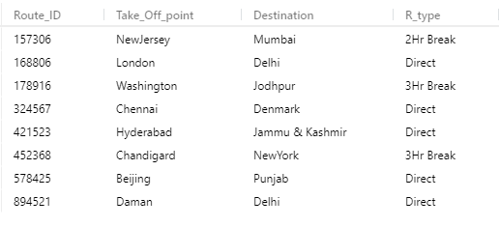
INSERT INTO Route VALUES(168806,'London','Delhi','Direct');
INSERT INTO Route VALUES(157306,'NewJersey','Mumbai','2Hr Break');
INSERT INTO Route VALUES(178916,'Washington','Jodhpur','3Hr Break');
INSERT INTO Route VALUES(324567,'Chennai','Denmark','Direct');
INSERT INTO Route VALUES(452368,'Chandigard','NewYork','3Hr Break');
INSERT INTO Route VALUES(894521,'Daman','Delhi','Direct');
INSERT INTO Route VALUES(578425,'Beijing','Punjab','Direct');
INSERT INTO Route VALUES(421523,'Hyderabad','Jammu & Kashmir','Direct');
SELECT * FROM Route;

Slide 16
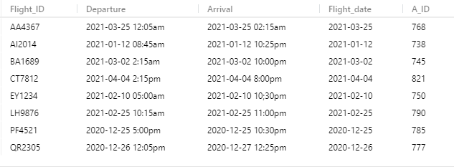
INSERT INTO Flight VALUES('AI2014','2021-01-12 08:45am','2021-01-12 10:25pm','2021-01-12',738);
INSERT INTO Flight VALUES('QR2305','2020-12-26 12:05pm','2020-12-27 12:25pm','2020-12-26',777);
INSERT INTO Flight VALUES('EY1234','2021-02-10 05:00am','2021-02-10 10;30pm','2021-02-10',750);
INSERT INTO Flight VALUES('LH9876','2021-02-25 10:15am','2021-02-25 11:00pm','2021-02-25',790);
INSERT INTO Flight VALUES('BA1689','2021-03-02 2:15am','2021-03-02 10:00pm','2021-03-02',745);
INSERT INTO Flight VALUES('AA4367','2021-03-25 12:05am','2021-03-25 02:15am','2021-03-25',768);
INSERT INTO Flight VALUES('CT7812','2021-04-04 2:15pm','2021-04-04 8:00pm','2021-04-04',821);
INSERT INTO Flight VALUES('PF4521','2020-12-25 5:00pm','2020-12-25 10:30pm','2020-12-25',785);
SELECT * FROM Flight;

Slide 17
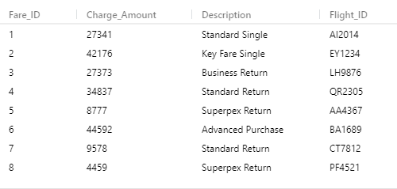
INSERT INTO AirFare VALUES(1,27341,'Standard Single','AI2014');
INSERT INTO AirFare VALUES(4,34837,'Standard Return','QR2305');
INSERT INTO AirFare VALUES(2,42176,'Key Fare Single','EY1234');
INSERT INTO AirFare VALUES(3,27373,'Business Return','LH9876');
INSERT INTO AirFare VALUES(6,44592,'Advanced Purchase','BA1689');
INSERT INTO AirFare VALUES(5,8777,'Superpex Return','AA4367');
INSERT INTO AirFare VALUES(7,9578,'Standard Return','CT7812');
INSERT INTO AirFare VALUES(8,4459,'Superpex Return','PF4521');
SELECT * FROM AirFare;

Slide 18
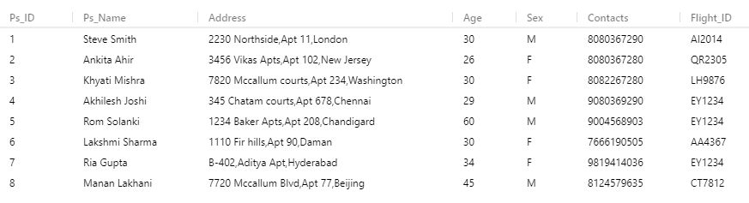
INSERT INTO Passengers VALUES(1,'Steve Smith','2230 Northside,Apt 11,London',30,'M','8080367290','AI2014');
INSERT INTO Passengers VALUES(2,'Ankita Ahir','3456 Vikas Apts,Apt 102,New Jersey',26,'F','8080367280','QR2305');
INSERT INTO Passengers VALUES(4,'Akhilesh Joshi','345 Chatam courts,Apt 678,Chennai',29,'M','9080369290','EY1234');
INSERT INTO Passengers VALUES(3,'Khyati Mishra','7820 Mccallum courts,Apt 234,Washington',30,'F','8082267280','LH9876');
INSERT INTO Passengers VALUES(5,'Rom Solanki','1234 Baker Apts,Apt 208,Chandigard',60,'M','9004568903','EY1234’);
INSERT INTO Passengers VALUES(6,'Lakshmi Sharma','1110 Fir hills,Apt 90,Daman',30,'F','7666190505','AA4367');
INSERT INTO Passengers VALUES(8,'Manan Lakhani','7720 Mccallum Blvd,Apt 77,Beijing',45,'M','8124579635','CT7812');
INSERT INTO Passengers VALUES(7,'Ria Gupta','B-402,Aditya Apt,Hyderabad',34,'F','9819414036','EY1234');
SELECT * FROM Passengers;

Slide 19
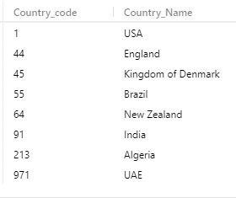
INSERT INTO Countries VALUES (+44,'England');
INSERT INTO Countries VALUES (+1,'USA');
INSERT INTO Countries VALUES (+91,'India');
INSERT INTO Countries VALUES (+45,'Kingdom of Denmark');
INSERT INTO Countries VALUES (+64,'New Zealand');
INSERT INTO Countries VALUES (+971,'UAE');
INSERT INTO Countries VALUES (+213,'Algeria');
INSERT INTO Countries VALUES (+55,'Brazil');
SELECT * FROM Countries;

Slide 20
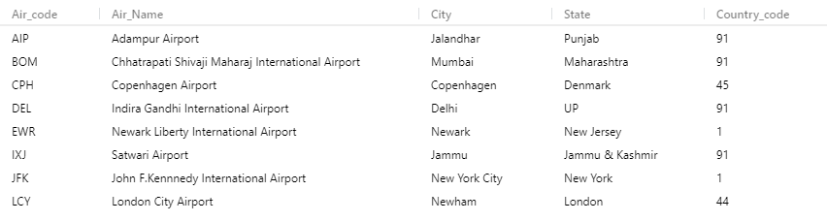
INSERT INTO Airport VALUES('DEL','Indira Gandhi International Airport','Delhi','UP',+91);
INSERT INTO Airport VALUES('BOM','Chhatrapati Shivaji Maharaj International Airport','Mumbai','Maharashtra',+91);
INSERT INTO Airport VALUES('LCY','London City Airport','Newham','London',+44);
INSERT INTO Airport VALUES('EWR','Newark Liberty International Airport','Newark','New Jersey',+1);
INSERT INTO Airport VALUES('JFK','John F.Kennnedy International Airport','New York City','New York',+1);
INSERT INTO Airport VALUES('CPH','Copenhagen Airport','Copenhagen','Denmark',+45);
INSERT INTO Airport VALUES('AIP','Adampur Airport','Jalandhar','Punjab',+91);
INSERT INTO Airport VALUES('IXJ','Satwari Airport','Jammu','Jammu & Kashmir',+91);
SELECT * FROM Airport;

Slide 21
INSERT INTO Employees VALUES(1234,'Rekha Tiwary','202-Meeta Apt,Yogi Nagar,Mumbai‘
,30,‘rekha1234@gmail.com','+918530324018','DEL');
INSERT INTO Employees VALUES(3246,'John Dsouza','302-Fountain Apt,ElizaBeth Street,
Newham',26,'john2346@gmail.com','+447911123456','BOM');
INSERT INTO Employees VALUES(9321,'Sanjay Rathod','62-Patwa Apt,Pradeep Nagar,
Delhi‘,36,'sanjay78@gmail.com','+917504681201','LCY’);
INSERT INTO Employees VALUES(8512,'Hafsa Iqmar','1023-Prajwal Apt,Newark',41,
‘hafsa964@gmail.com','6465554468','EWR');
INSERT INTO Employees VALUES(7512,'Akshay Sharma','Akshay Villa,Queens Street,Copenhagen',20,‘akshay27@gmail.com','+45886443210','JFK');
INSERT INTO Employees VALUES(5123,'Lara Jen','28-Mark road,Victoria street,New York
City',31,'jenlara4@gmail.com','+448000751234','CPH');
INSERT INTO Employees VALUES(2458,'Johny Paul','45-Balaji Apt,Ajit Nagar,Jalandar',32,
‘johnypaul8@gmail.com','+919785425154','AIP');
INSERT INTO Employees VALUES(4521,'Nidhi Maroliya','6-Matruchaya Apt,Park Road,
Jammu',31,'nidhi785@gmail.com','+918211954901','IXJ');
SELECT * FROM Employees;

Slide 22
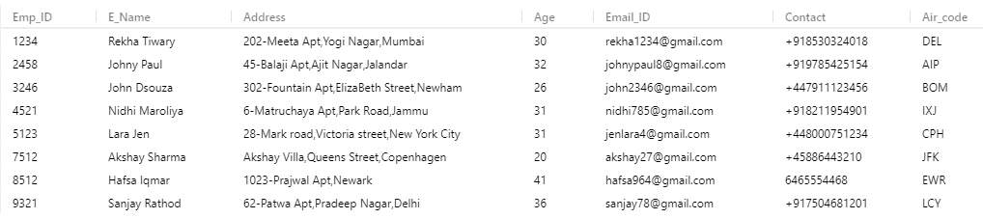
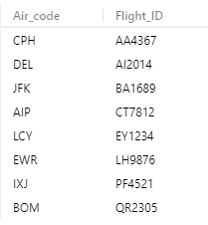
INSERT INTO Can_Land VALUES('DEL','AI2014');
INSERT INTO Can_Land VALUES('BOM','QR2305');
INSERT INTO Can_Land VALUES('LCY','EY1234');
INSERT INTO Can_Land VALUES('EWR','LH9876');
INSERT INTO Can_Land VALUES('JFK','BA1689');
INSERT INTO Can_Land VALUES('CPH','AA4367');
INSERT INTO Can_Land VALUES('AIP','CT7812');
INSERT INTO Can_Land VALUES('IXJ','PF4521');
SELECT * FROM Can_Land;

Slide 23
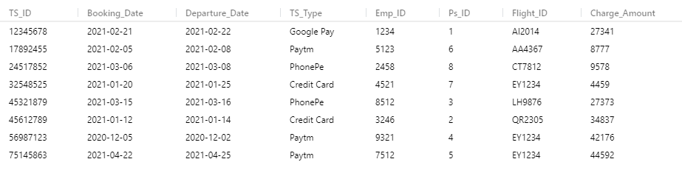
INSERT INTO Transactions VALUES(12345678,'2021-02-21','2021-02-22','Google Pay',1234,1,'AI2014',27341);
INSERT INTO Transactions VALUES(45612789,'2021-01-12','2021-01-14','Credit Card',3246,2,'QR2305',34837);
INSERT INTO Transactions VALUES(56987123,'2020-12-05','2020-12-02','Paytm',9321,4,'EY1234',42176);
INSERT INTO Transactions VALUES(45321879,'2021-03-15','2021-03-16','PhonePe',8512,3,'LH9876',27373);
INSERT INTO Transactions VALUES(75145863,'2021-04-22','2021-04-25','Paytm',7512,5,'EY1234',44592);
INSERT INTO Transactions VALUES(17892455,'2021-02-05','2021-02-08','Paytm',5123,6,'AA4367',8777);
INSERT INTO Transactions VALUES(24517852,'2021-03-06','2021-03-08','PhonePe',2458,8,'CT7812',9578);
INSERT INTO Transactions VALUES(32548525,'2021-01-20','2021-01-25','Credit Card',4521,7,'EY1234',4459);
SELECT * FROM Transactions;

Slide 24
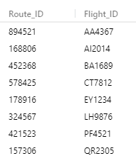
INSERT INTO Travels_on VALUES(168806,'AI2014');
INSERT INTO Travels_on VALUES(157306,'QR2305');
INSERT INTO Travels_on VALUES(178916,'EY1234');
INSERT INTO Travels_on VALUES(324567,'LH9876');
INSERT INTO Travels_on VALUES(452368,'BA1689');
INSERT INTO Travels_on VALUES(894521,'AA4367');
INSERT INTO Travels_on VALUES(578425,'CT7812');
INSERT INTO Travels_on VALUES(421523,'PF4521');
SELECT * FROM Travels_on;

Slide 25

SQL QUERIES
1. Display the flight-id and Passenger name travelling by Indigo Company.
SELECT F.Flight_ID, P.Ps_Name
FROM Airplane_type as A, Flight as F, Passengers as P
WHERE A.A_ID = F.A_ID AND
F.Flight_ID = P.Flight_ID AND
A.Company = 'Indigo';

Slide 26
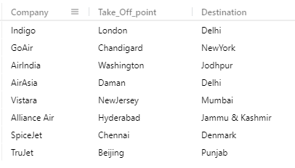
2. Display the route information for all flights.
SELECT A.Company, R.Take_Off_point, R.Destination
FROM Airplane_type as A, Flight as F ,Travels_on as T, Route as R
WHERE F.Flight_ID = T.Flight_ID
AND A.A_ID = F.A_ID
AND T.Route_ID = R.Route_ID;

Slide 27


3. Find the Employee-id of all employees whose name includes the substring
John.
SELECT Emp_ID, E_Name
FROM Employees
WHERE E_Name LIKE '%John%';
4. Find the sum of transaction charge amount travelled by flight-id = EY1234 for
each transaction type.
SELECT SUM(Charge_Amount) as total_charge, TS_Type
FROM Transactions
WHERE Flight_ID = 'EY1234'
GROUP BY TS_Type;

Slide 28
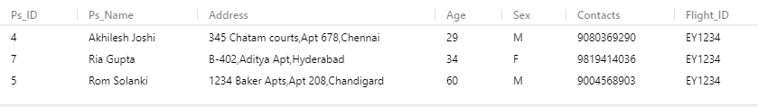
5.List in alphabetical order the names of all passengers travelling by flight-id EY1234.
SELECT P.*
FROM Passengers as P, Flight as F
WHERE P.Flight_ID = F.Flight_ID AND
F.Flight_ID = 'EY1234'
ORDER BY Ps_Name;

Slide 29

6. Display the company-name whose flight will be landed in mumbai airport.
SELECT Company, A_ID
FROM Airplane_type
WHERE A_ID in (SELECT A_ID
FROM Flight
WHERE Flight_ID in (SELECT Flight_ID
FROM Can_Land
WHERE Air_code in (SELECT Air_code
FROM Airport
WHERE City = 'Mumbai')));

Slide 30
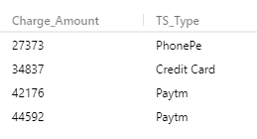
7. Find the Transaction-type whose transaction amount is greater than Google
Pay transaction-type.
SELECT Charge_Amount, TS_Type
FROM Transactions
WHERE Charge_Amount > some (SELECT Charge_Amount
FROM Transactions
WHERE TS_Type = 'Google Pay');

Slide 31

8. Find all country name with more than one airport.
SELECT Country_Name, count(*) as Airport_count
FROM Airport as A,Countries as C
WHERE A.Country_code = C.Country_code
GROUP BY C.Country_name
HAVING count(*) > 1;

Slide 32

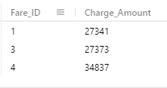
9. Find the largest charge-amount of any transaction-type.
SELECT max(total_bal) as largest_transaction
FROM (SELECT TS_Type, sum(Charge_Amount) as total_bal
FROM Transactions
GROUP BY TS_Type) as result;
10. Find the Fare-id of those with Charge-amount between 20000 and 35000.
SELECT Fare_ID, Charge_Amount
FROM AirFare
WHERE Charge_Amount BETWEEN 20000 AND 35000 ;

Slide 33

11. Find the average charge-amount of those transactiontype whose average charge
amount is greater than 20,000.
SELECT TS_Type, avg_bal
FROM (SELECT TS_Type, avg(Charge_Amount) as avg_bal
FROM Transactions
GROUP BY TS_Type) as result
WHERE avg_bal > 20000;

Slide 34
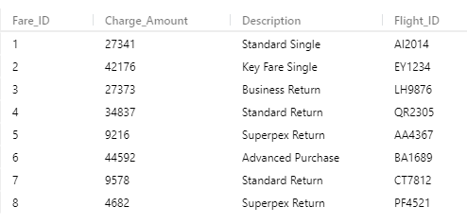
12. Increase the charge-amount by 5% whose class is Superex Return.
UPDATE AirFare
SET Charge_Amount = Charge_Amount * 1.05
WHERE Description = 'Superpex Return';
AirFare Table after 5% increase
Initial AirFare Table

Slide 35
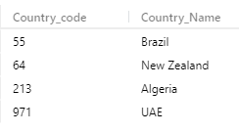
13. Display the country-name that does not have an airport.
SELECT Country_code, Country_Name
FROM Countries
WHERE Country_code NOT IN (SELECT Country_code
FROM Airport);

Slide 36
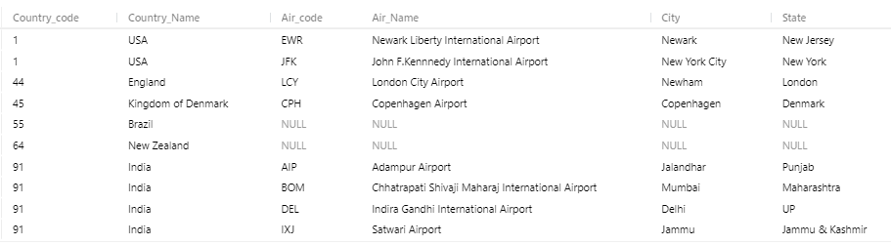
14. Display All the counties that may have or may not have the Airport.
SELECT *
FROM Countries NATURAL LEFT OUTER JOIN Airport;

